Slide 1
Incident Response Tracking System
Lylybell Teran, Sophia Martuscello, Ann Sam and Amna Quadri

Slide 2
Introduction- Roles
Lylybell Teran
Ann Sam
01
Sophia Martuscello
Amna Quadri
Created and normalized the Entity Relationship Diagram
Completed the Database Design and implemented the necessary tables and keys
Worked on the implementation of SQL statements in PHP and HTML as well as formatting the webpage for a logical page layout and navigation
Wrote the report that include all requested diagrams, schemas, and SQL queries

Slide 3

Introduction- Case Analysis
Our goal for this system is to create a system that records incidents as they occur.
Each incident has a unique identifier and has a list of things to be recorded, for example, the date it was created.
It also could have any number of people and IP addresses associated with it.
Incident responders can record a new incident and receive a report containing the full history of it.
The tracking system can export each incident to a standard incident exchange format and send it via email.
Notes:
Our main goal for this project is to create a system that records incidents as they occur.
Each incident has an unique identifier as well as a list of things to be recorded for example the type of incident.
Each incident has any number of people and IP addresses associated with it
Repsonders are able to record and receive a report about an incident
The tracking system can export an incident and send it via emaill

Slide 4
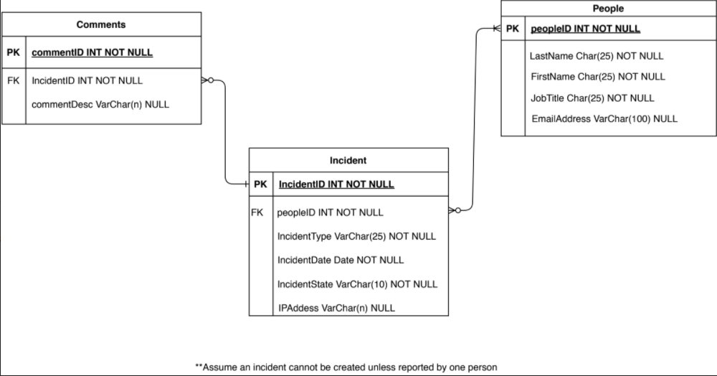
Unnormalized ERD Diagram

Slide 5
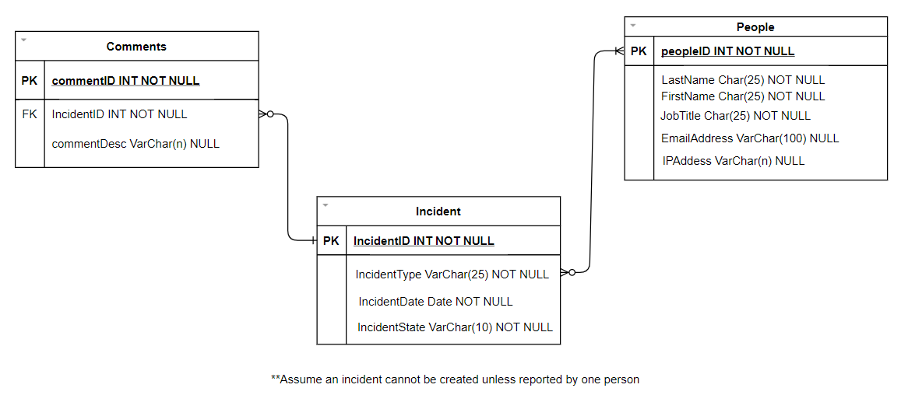
Entity-Relationship Model

Slide 6
Degree of the Relationships
Incident to People: Zero or Many-N relationship because a person can also have zero or many incidents.
Comment to Incident: Zero or Many-1 relationship because one incident can have zero or many comments associated to a specific incident
Notes:
There has to be a person if there is an incident but there doesn't have to be an incident if there is a person.

Slide 7
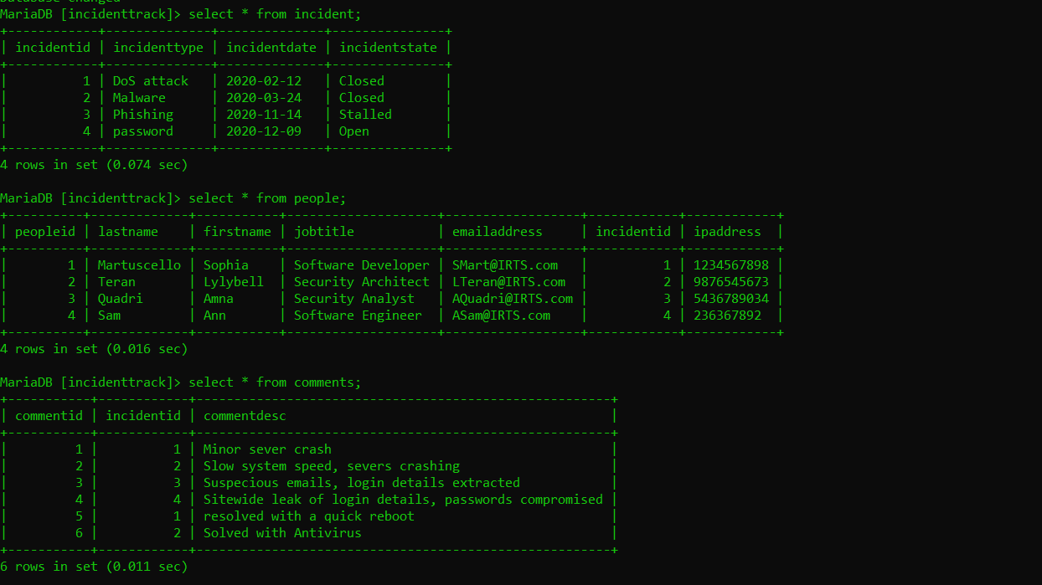
SQL Database
Notes:
In the database, there are three tables; Incident, people, and comments. The Incidents table contains IncidentId, incident type, incident date, and the state of the incident. The people table has the ID of each person, their last names and first names, job titles, email addresses, and ip addresses. This table also contains the incidentIDs in order to connect both the incident and people tables together. The comments table contains the id for comments, incident ids and a couple short descriptions of the incidents in comment form. All of the ids in the tables (commentID, peopleID, incidentID) are auto_incrementing.

Slide 8
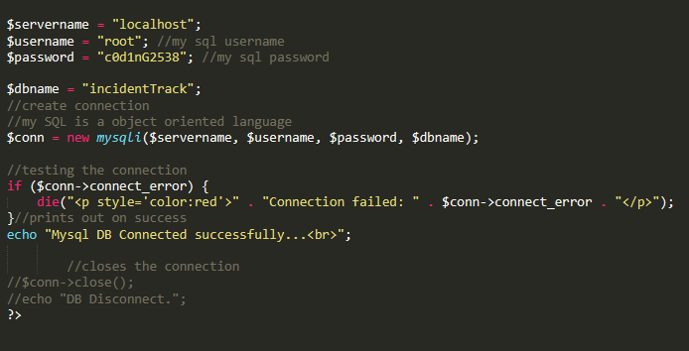
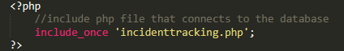
Connecting PHP to SQL
incidenttrack.php
This php file containing the connection to mysql database is included in every php file for this assignment by using the include_once keyword seen below
“password”

Slide 9
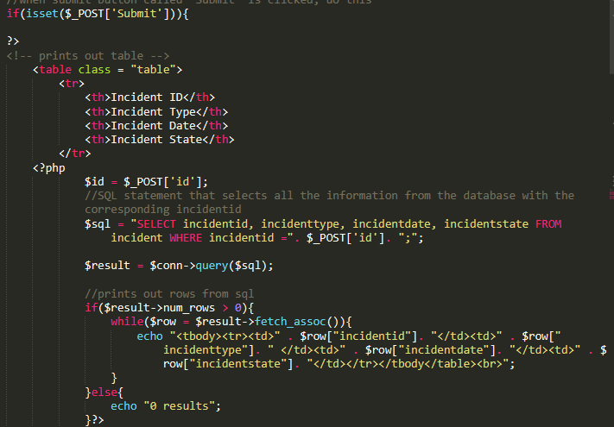
HTML/PHP Implementation Continued...
incidentview.php
User inputs a incident id to search as discussed in the previous slide
This $SQL statement prints out all the information from table incident where the incidentid equals the user inputted id (‘$id’)
if($result->num_rows > 0) This section of code prints out any row in the incident table that has this id Else{ prints ‘0 results’ to tell the user no incident has this incidentid
This is repeated for table people and comments separately for organization
Notes:
This page is for viewing the full history of each incident in the database
The sql statement selects everything in the table incident where the incident id is equal to what the user inputted.
This section of code prints out any row that has this id, as long as there is a row to print. If not, then an error message is printed out, informing the user that no rows match their input.
This method was repeated for the other two tables.

Slide 10
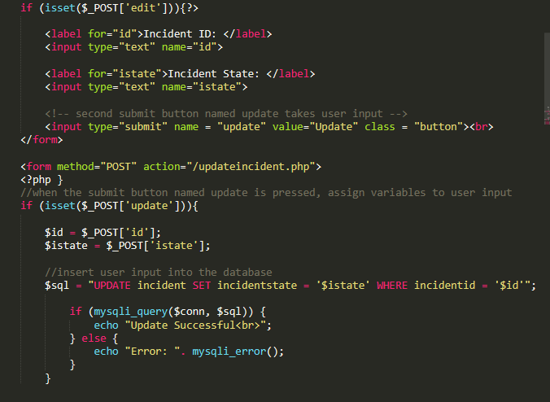
HTML/PHP Implementation Continued...
updateincident.php
This page initially prints out table incident with a submit button‘edit’ on the bottom
When ‘edit’ is pressed, two user input forums pop up, one for incidentid and one for incidentstate
When user presses ‘update’, $sql updates incidentstate to whatever the user input where the incidentid equals the user inputted id

Slide 11
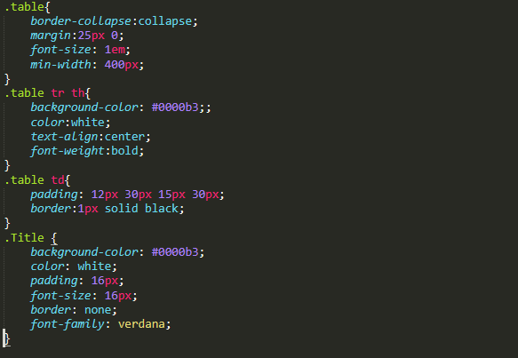
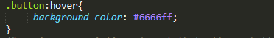
CSS Implementation in HTML
style.css
Adding a style sheet allowed me to style elements of the HTML by class name and HTML tag such as <tr> or <td>
Special built-in commands like :hover allow me to change the background-color of elements with the class .button when hovered over by the user

Slide 12
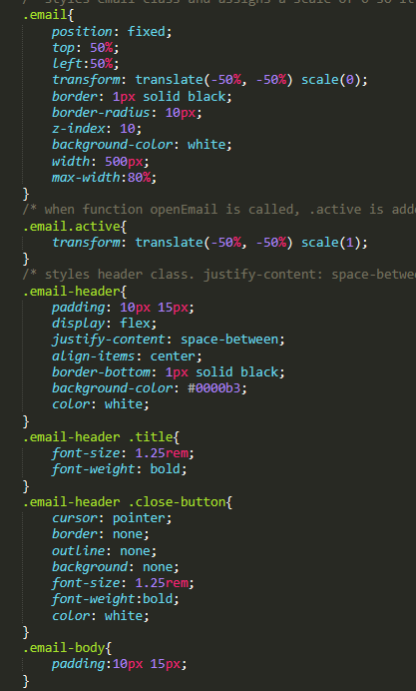
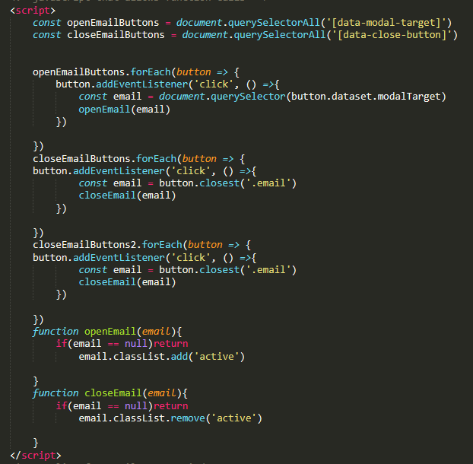
Javascript and CSS Implementation
incidentview.php
Combining CSS and javascript allowed me to create a pop up email window
scale(0) under .email allows me to hide the pop out window when the page loads
By adding functions in javascript when button is pressed, I can change the scale of the .email class to change so it appears and disappears as the user wishes

Slide 13
Questions…???

Slide 14

Thank you Professor!! :)

